Slide 1

Cache Coherence
Member:
>Tenzin
>Paul
>Nishaun

Slide 2
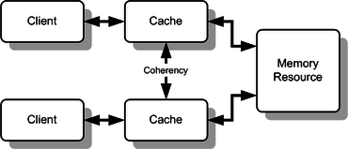
Cache Coherence ?
Consistency of shared resource
Ensure not overwritten or lost
Different techniques:
Directory protocol
Snooping protocol
M.E.S.I.
Also known: Cache Consistency

Slide 3
Reading from Cache
CPU wants to read from memory
CPU sends address to Cache Controller
Lowest k bits of m bit address are index of block in cache
Test if cache hit
Is block valid?
Tag of block is m - k bits
If hit, you have your data faster than MM access

Slide 4
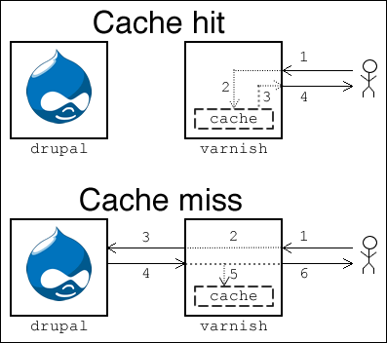
Cache Miss
Fails cache hit test
Adds a time penalty
Pipeline can stall
Find data in the memory
(Sometimes) write the missing data into the cache
Deliver data to user

Slide 5
Cache Miss
Accessing main memory takes long time
Goal is shortest time to access data
To avoid accessing main memory and cache miss penalty
Larger cache
Better updated cache

Slide 6
Writing to Cache
Stores data in a faster storage unit, can dramatically speed up processing time
How do we manage data stored in cache
Keep it updated?
Keep it relevant?
Four ways

Slide 7
Writing to Cache
Write through
Updates cache and MM all the time
Lots of memory updates
Write back
Memory updated only when block needs to be replaced
Modified data in cache is marked as dirty

Slide 8
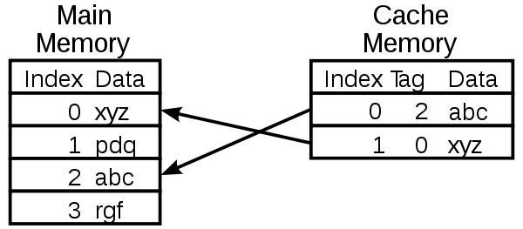
Write Miss
What if we want to update the data at index 3 in MM?
What happens if we try to write to cache?
Write miss
Time penalty

Slide 9
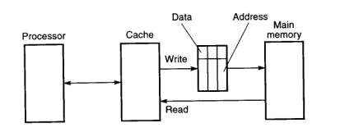
Allocate?
Allocate on Write
Load new data into cache
Efficient for frequent access
Write Around
Write directly to MM
Efficient for infrequent access

Slide 10
Hardware Solution:
A Hardware approach has advantages over a software approach
The issues are dealt with as they arise, thus conservation of resources
This allows for the cache to perform more efficiently
Two approaches available from a hardware perspective are the Directory Protocol method, and the Snooping Protocol method.

Slide 11
Directory Protocol:
The Directory maintains information regarding the state of every block of memory, and about which blocks contain what data.
The Directory serves as a checkpoint- whenever a request is made by a processor to read or write data within the cache, the directory will check each block and convey commands accordingly.
If writing over data, the directory will locate the other cached copies of the line and order that they be invalidated, or updated to match the new written value
The processor then gains exclusive rights to this line
*

Slide 12
Directory Protocol:
When a processor attempts to access data that is under the exclusive rights of another processor, the processor will send a miss notification to central controller
The controller then commands the processor with the rights to the line to do a write back to the main memory.
At this point, the data is now available for both processors

Slide 13
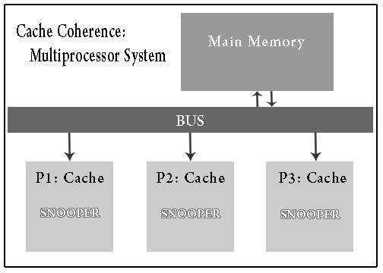

Snoopy Protocol:
Distribute responsibility
Use BUS
Each Cache able to “Snoop”
Helps update status
Example: MESI protocol

Slide 14
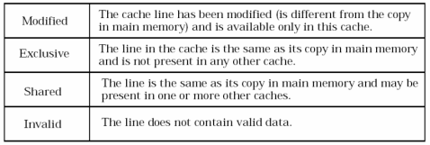
MESI Protocol :
Four State in which a cache line can exist.
Modified, Exclusive, Shared, Invalid ( M.E.S.I. )

Slide 15
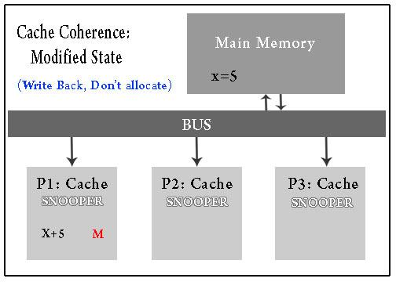
Modified State :
Write Back & Write Through
Write Back policy:
Save access time for BUS and Memory
Update Cache only
Write Through:
Access BUS and Memory
Update Both Cache & Memory

Slide 16

Exclusive State :
Exclusive State:
The line in the cache is the same as its copy in M.M. and is not present in any other cache

Slide 17
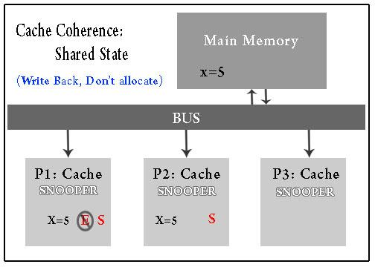
Shared State :
Shared State:
The line is the same as its copy in M.M. and may be present in one or more other caches.

Slide 18
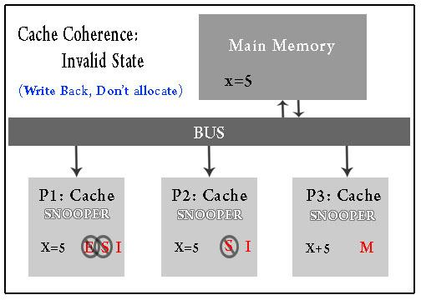
Invalid State :
Invalid State:
The line does not contain valid data.

Slide 19
Bibliography
Patterson, David A., and John L. Hennessy. "Computer Organization and Design : The Hardware/Software Interface with CD 4th." ISBN 9780123747501. Morgan Kaufmann, n.d. Web. 06 Aug. 2016.
https://www.techopedia.com/definition/300/cache-coherence
https://www.cs.utah.edu/~rajeev/cs7820/pres/08-7820-02.pdf

Slide 20


